Slide 1
S5 pART 2
sHAVON pARKER

Slide 2
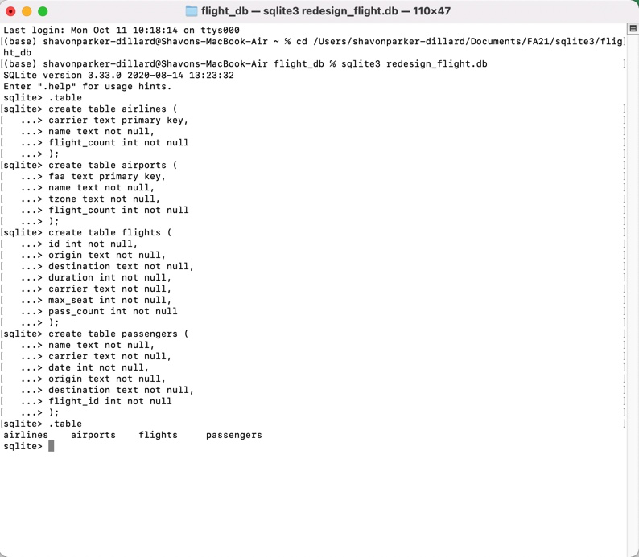
CREATION OF DATABASE AND TABLES
CREATION OF REDESIGN_FLIGHT.DB
CREATION OF 4 TABLES
AIRLINES
AIRPORTS
FLIGHTS
PASSENGERS

Slide 3
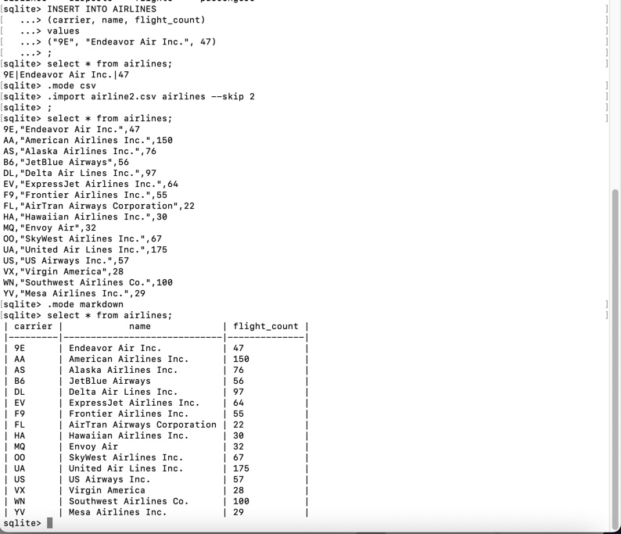
Data insertion
Single data insertion into the airlines table
Remaining data inserted using csv method

Slide 4
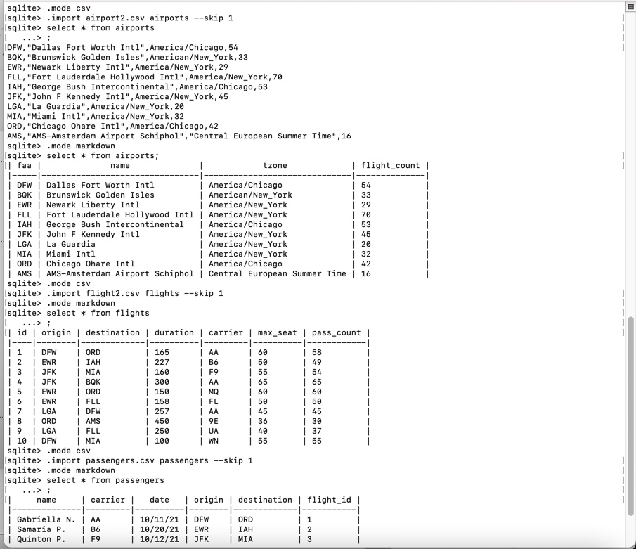
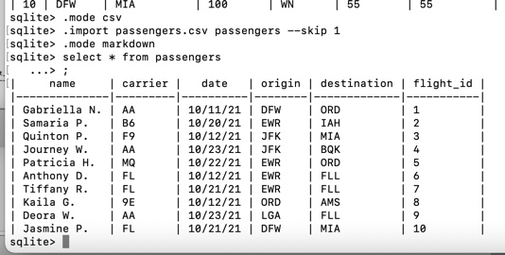
Remaining table’s data was added using the csv method

Slide 5
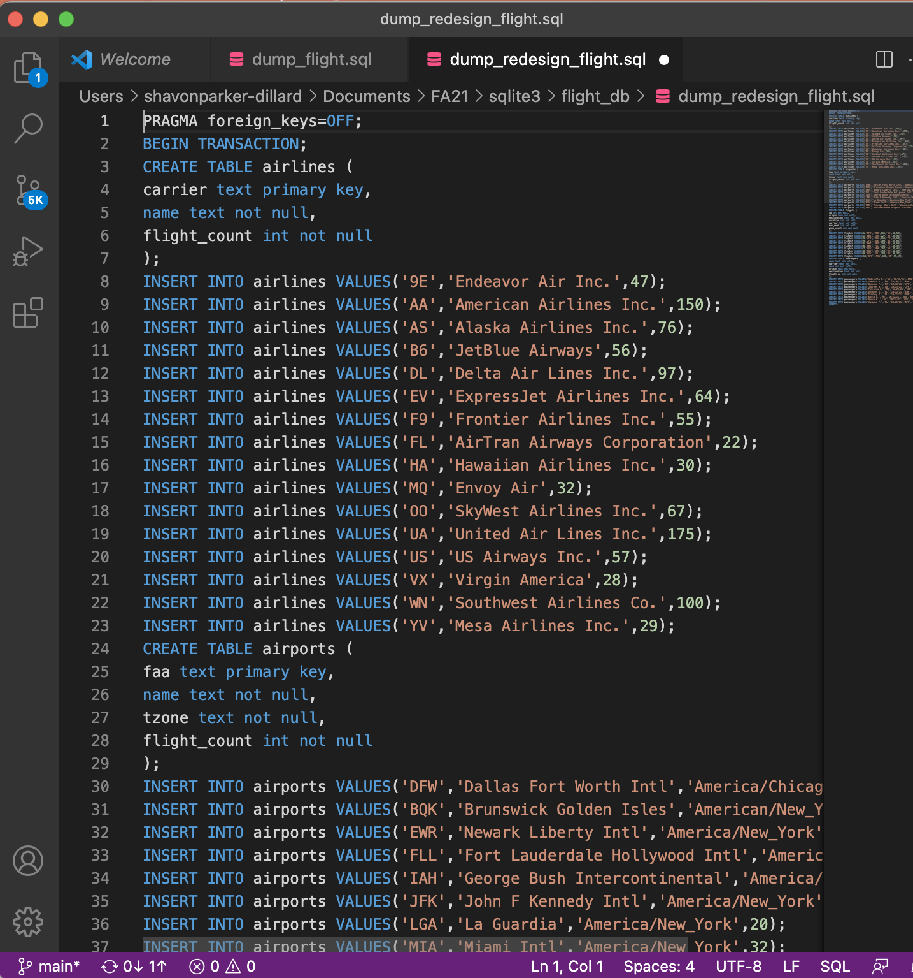
Dump of new flight

Slide 6
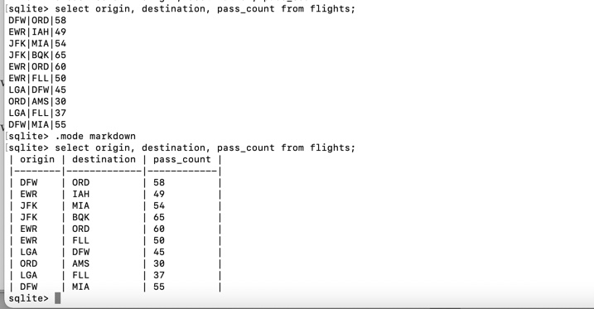
Sql statement 1
Count passengers per flight

Slide 7
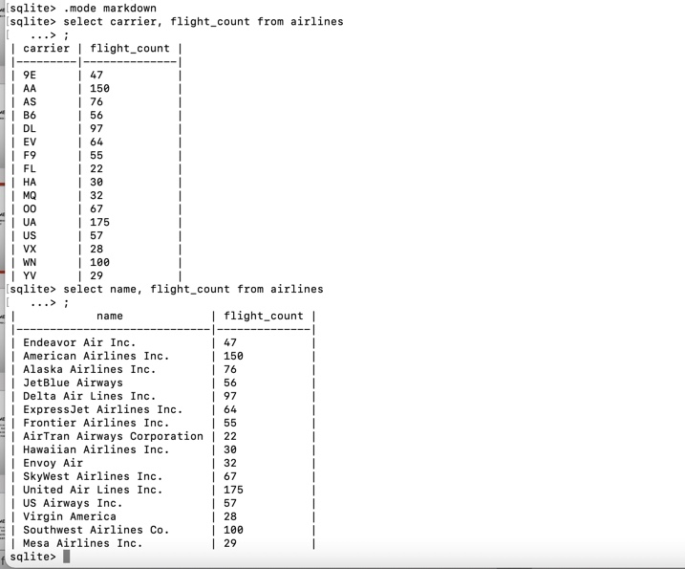
Sql statement 2
Count flights per carrier

Slide 8
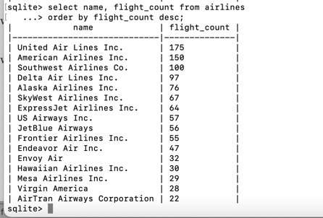
Sql statement 3
Top-k airports in terms of flight count

Slide 9
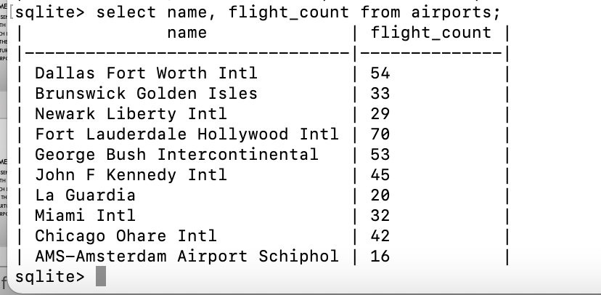
Sql statement 4
Count flights per airport

Slide 10
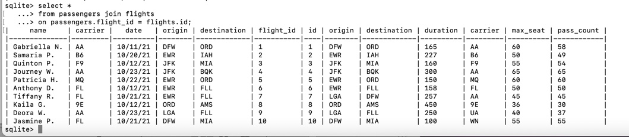
Sql statement 5
Get the passengers along with their flights; each flight comes with the faa of both departure and arrival airports

Slide 11
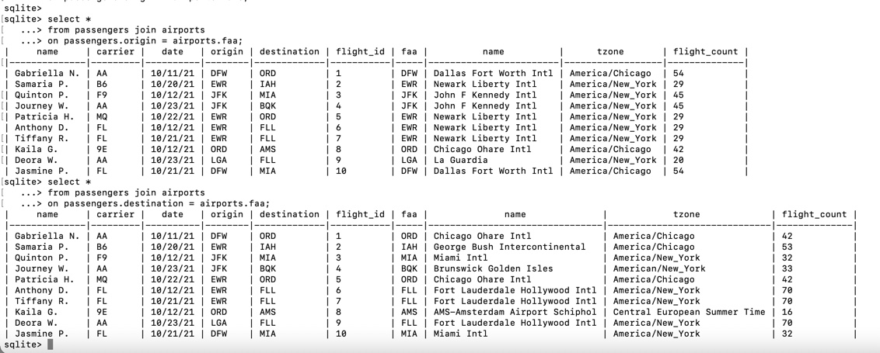
Sql statement 6
Get the passengers along with their flights; each flight comes with the name of both departure and arrival airports

Slide 12
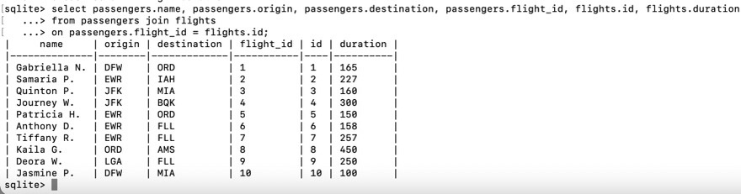
Sql statement 7
Get the passengers with the duration of their flights

